Slide 1
Principal Component Analysis
Arif Istiake Sunny
sunny1509006@gmail.com

Slide 2
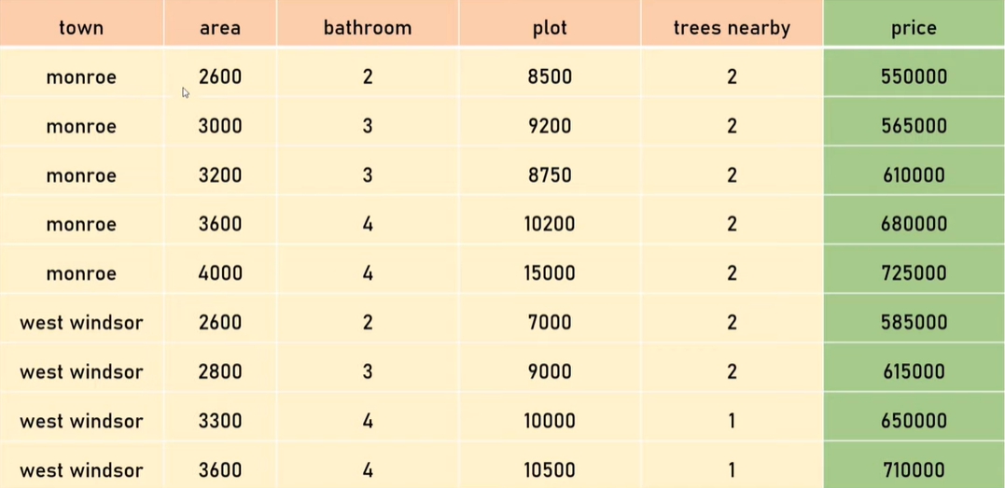

Slide 3
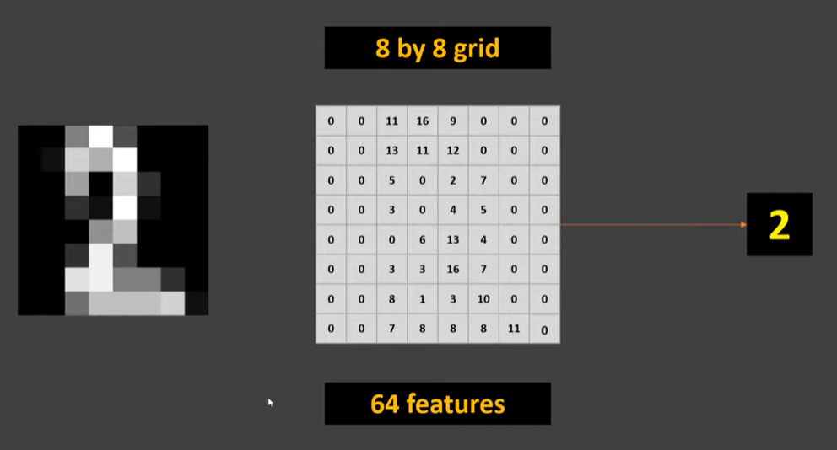

Slide 5
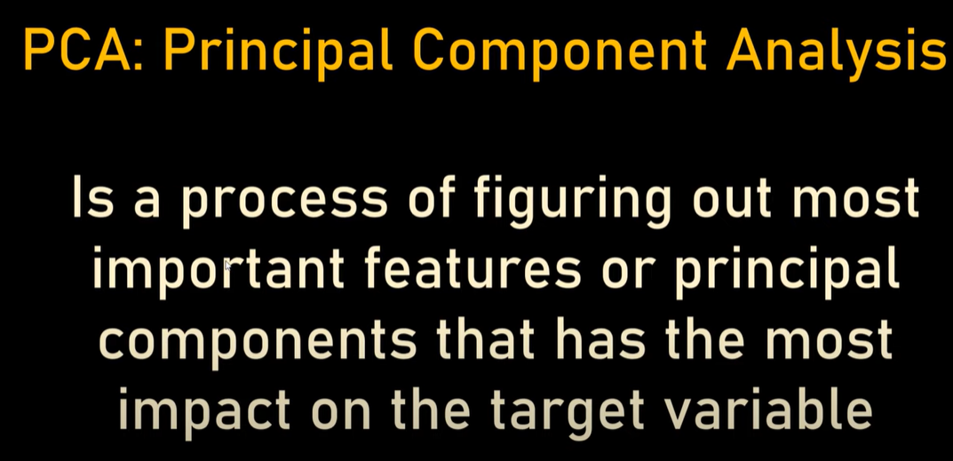

Slide 7
